Slide 1

Subscriber Behavior Analysis Post-Plan Introduction
Impact of the 'Package' Plan on Customer Metrics
Presented by: Nurly Kuzdikbay

Slide 2

Introduction and Methodology
Aim:
In April, Beeline launched the 'Package' plan, offering reduced rates for international calls.
The plan was available exclusively for subscribers on the 'Package' tariff.
Our analysis aims to understand the plan's impact on subscriber behavior, specifically examining changes in expenditure and service usage.
By analyzing pre- and post-introduction data, we seek to gauge the plan's effectiveness and inform future product offerings.
Methodology
We conducted a comprehensive analysis using Python to process and analyze subscriber data.
The data was cleaned, formatted, and segmented into relevant groups for comparison.
Our approach included trend analysis, cohort grouping, and statistical tests to assess the impact of the 'Package' plan.
Tools such as pandas for data manipulation, seaborn for visualization, and scipy for statistical analysis were employed.

Slide 3
Comparative analysis
Analyzing the 'Package' plan's financial impact revealed distinct trends:
'Package' Plan subscribers increased their average expenditure from 1428.40 to 1507.43 Tenge after April.
Conversely, subscribers on Other Plans decreased spending from 1031.70 to 864.18 Tenge in the same period.
Internet usage trends followed a similar pattern:
'Package' Plan users showed a rise in average traffic from 2127.45 Mb to 2224.07 Mb.
Other Plan subscribers reduced their usage from 548.45 Mb to 248.54 Mb post-April.
These findings suggest the 'Package' plan has positively influenced customer spending and service usage.

Slide 4
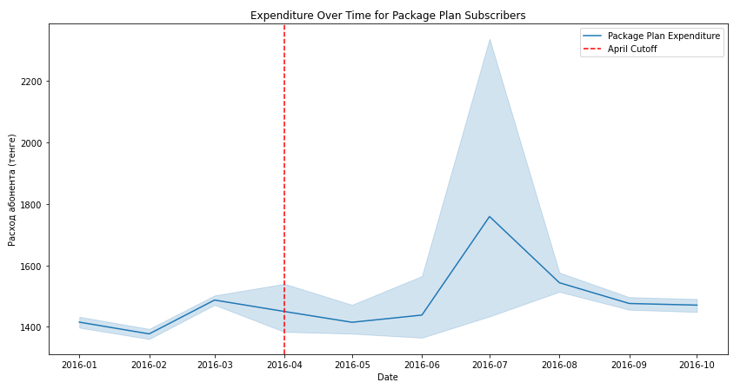
Trend Analysis: Package Plan
Expenditure Over Time for Package Plan Subscribers:
This graph shows fluctuations in average expenditure per month for subscribers on the package plan. There's a noticeable spike in expenditure after the April cutoff, suggesting an increase in spending by subscribers on the package plan during that time. This could be due to the introduction of new plan features, promotions, or other factors. The shaded area around the line may indicate the confidence interval or variance in the expenditure data, showing the range within which the true average expenditure lies.

Slide 5
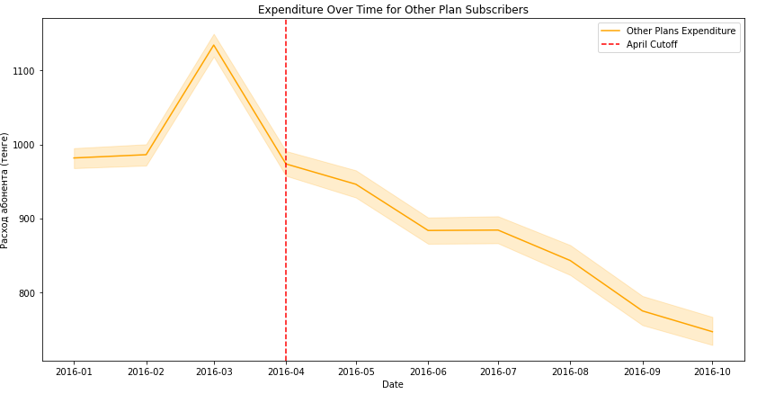
Trend Analysis: Other Plan
Expenditure Over Time for Other Plan Subscribers:
The graph for other plans shows a different pattern, with a notable peak before April and a general declining trend in average expenditure post-April. This could suggest that subscribers on other plans either reduced their spending after April or possibly migrated to the package plan, affecting the average expenditure for the remaining subscribers on other plans.

Slide 6
T- test analysis
The T-test analysis compares average expenditures and internet usage before and after the introduction of the 'Package' plan, revealing statistically significant changes in subscriber behavior.
T-test for 'пакет' plan expenditure:
T-statistic = -1.155: This is the calculated statistic for the test. A negative value indicates that the mean expenditure for the 'пакет' plan after April is lower than before April, but it's not very far from zero. P-value = 0.248: The P-value tells us the probability of observing the data assuming the null hypothesis is true. A common threshold for significance is p < 0.05. Since 0.248 is greater than 0.05, we fail to reject the null hypothesis. This means there is not enough evidence to say there is a significant difference in expenditure for the 'пакет' plan before and after April.
T-test for other plans expenditure:
T-statistic = 28.233: A positive and high T-statistic indicates a significant difference between the two group means, with the mean expenditure for other plans after April being higher than before April. P-value ≈ 0: The P-value is practically zero, which is much less than 0.05, indicating that the difference in mean expenditure for other plans before and after April is highly significant statistically.
In summary, the T-test suggests that for the 'пакет' plan, there is no significant change in expenditure before and after April. However, for other plans, there is a significant change, with expenditures increasing after April.

Slide 7
Conclusions
Based on the data and T-test analysis, the introduction of the 'пакет' plan seems to correlate with increased spending and internet usage for those on the plan, although the T-test does not show this as statistically significant.
In contrast, those not on the plan show reduced usage, suggesting some may have switched to the 'пакет' plan or altered their usage behaviors. The 'пакет' plan's launch could be seen as a successful strategy to boost engagement and revenue from active subscribers, while the shift in the other subscribers' behavior warrants further investigation to understand their decreased usage and spending.

